Slide 1


Hii,
Iam Siddhika
Welcome to Power BI Series
Part -86

Slide 2


Today Content
I’m very excited to dive into this with you all!
Are you ready to enhance your data visualization skills?
VISUALIZING DATA
ROW-LEVEL SECURITY (RLS)(CONTINUATION)
2.Dynamic RLS

Slide 3


2.DYNAMIC RLS
see next
Dynamic RLS allows access to data to change based on the user who is logged in. Instead of hard-coding the country, a dynamic filter can use user information (e.g., email or username) to filter the data automatically.
Use Case Example:
Allow users to see sales data for their assigned country dynamically, based on their username.

Slide 4

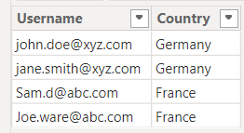
Steps to Set Up Dynamic RLS:
1. Create a User Mapping Table:
You need a separate table that stores the users and the regions they are responsible for.
For example:
do along with
me
2.Import the User Mapping Table into Power BI:
This can be done by importing a CSV file or creating the table in Power BI manually.

Slide 5
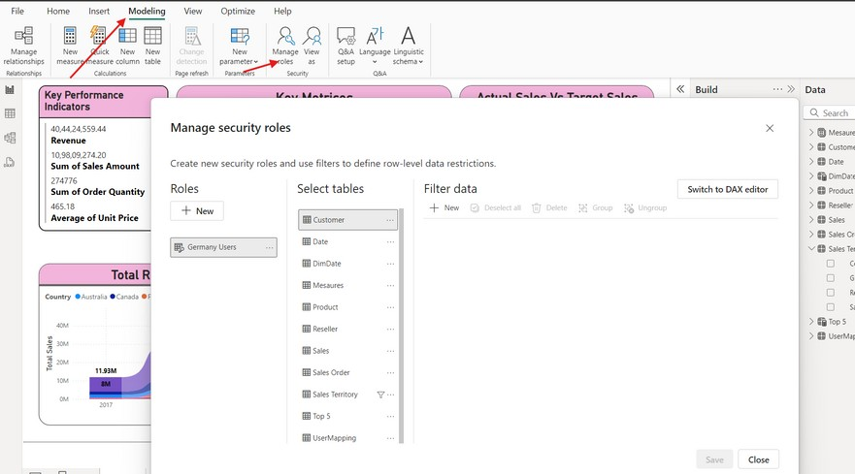


3.Go to the Modeling Tab:
Click on “Manage Roles” again, and this time we will create a dynamic rule.
Easy..see
next

Slide 6
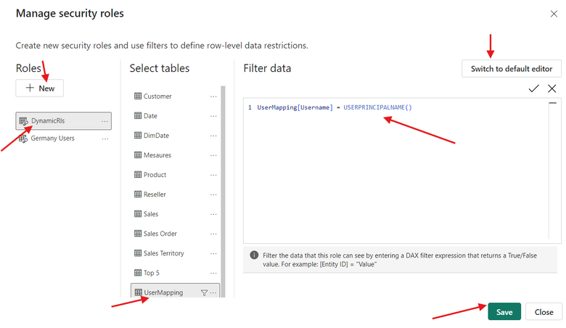
4.Create a Dynamic Role:
Create a new role called DynamicRls.
select Usermapping table,swith to dax editor.
Write the dax code as
USERPRINCIPALNAME()
login save it
shown in image. we use function to get email who
if you want to know
more about
USERPRINCIPALNAME,
Then check our DAX
part....

Slide 7
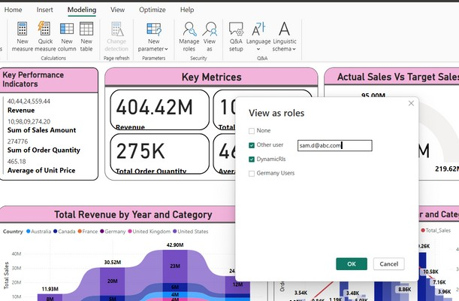
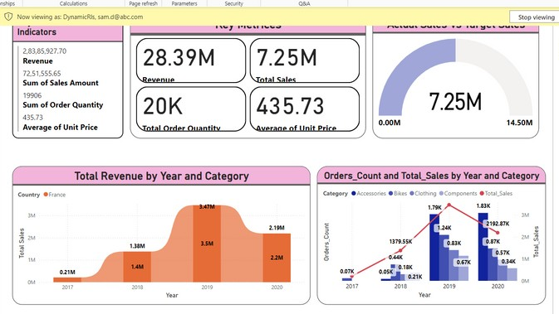
5.Assign Users Automatically:
Dynamic RLS does not require manually assigning users because it is based on the username of the logged-in user.
You can test like below by viewing as other user
Go and
try..
here
sam.d@abc.com
belongs to france country.so we can see data for france

Slide 8

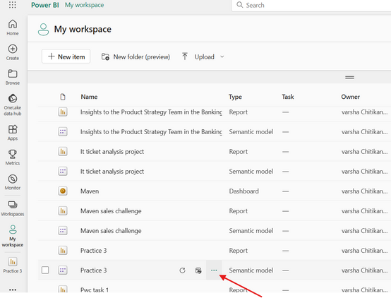
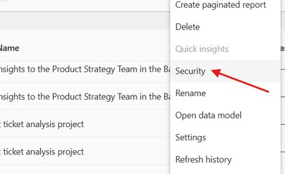
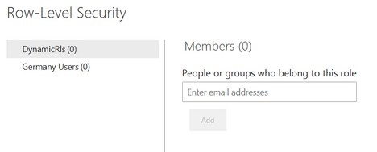
5.Assign Users to Roles (Service Level):
Its on PBI
After publishing the report to Power BI Service, go to the our file dataset on workspace. Click on 3 dots
click on "Security” from all the options. assign users to the DynamicRls based on their access level. add all emails
Service.
I dont have any
mails to add. so
I have not done
You do not need to add individual emails for Dynamic RLS in the Power BI service. Instead, you can automate and manage the process efficiently using:
Azure AD Security Groups
User Mapping Table (connected to a source like a database or SharePoint)
Power Automate or Power BI REST API for automation

Slide 9


Thank you for joining me today to learn about Part -86
of Power BI!
Remember, Effective data visualization is crucial for turning data into meaningful insights and compelling narratives with Power BI.
Stay tuned for more insights and tips on Power BI in our next Series.
Follow
Siddhika Shah

